Slide 1
Module 4
File handling

Slide 2
Background
Console oriented I/O functions use keyboard as input device and monitor as output device.
The I/O functions like printf(), scanf(), getchar(), putchar(), gets(), puts()
Problem:
  Entire data is lost when either the program is terminated or the computer is turned off.
  When the volume of data to be entered is large, it takes a lot of time to enter the data.
Solution: File

Slide 3
Defining and Opening a file
The general format for declaring and opening a file is:
FILE *fp; ---------(1)
fp=fopen(“filename”, “mode”); -------(2)
1st-declares the variable fp as a “pointer to the data type FILE”.
2nd-declares to C what processing is to be done with the file- read it, write into it, append to it, etc.
This call will initialize an object of the type FILE, which contains all the information necessary to control the stream.

Slide 4
File Opening Modes
Mode | Description
r | Opens a text file for reading.
w | Creates a text file for writing
a | Append to a text file
r+ | Opens a text file for read / write.
w+ | Creates a text file for read / write.
a+ | Append or create a text file for read / write.
Mode | Description
rb | Opens a binary file for reading.
wb | Creates a binary file for writing
ab | Append to a binary file
r+b | Opens a binary file for read / write.
w+b | Creates a binary file for read / write.
a+b | Append a binary file for read / write.

Slide 5
Steps for using Files in C
Declare a File pointer variable.
Open a file using the fopen ( ) function.
Process the file using suitable function.
Close the file using fclose ( ) function.
File *fp;
Returns file pointer on success or throws NULL upon encountering error.
Returns 0 on success or throws -1 upon encountering error.

Slide 6
File opening in Read Mode
#include <stdio.h>
void main()
{
FILE *fp;
char ch;
fp = fopen("abc.txt", "r");
if ( fp== NULL)
{
printf(" The file does not exist");
}
while((ch=fgetc(fp))!=EOF)
{
printf("%c",ch);
}
fclose(fp);
}

Slide 7
File opening in write Mode
#include <stdio.h>
void main()
{
FILE *fptr;
char filename[15]= "myfile.txt";
fptr = fopen (filename,"w"); //fptr = fopen ("myfile.txt","w"); this can also be written
if (fptr == NULL)
{
printf ("Cannot open file to write!\n");
exit(-1);
}
fprintf (fptr,"Hello World!\n");
fclose(fptr);
}

Slide 8
File opening in Appened Mode
#include<stdio.h>
#include<conio.h>
void main()
{
FILE *fp;
clrscr();
fp = fopen(“myfile.txt", "a");
if (fp==NULL)
{
printf(" The file does not exist");
}
fprintf(fp, "This is testing for appending...\n");
fclose(fp);
getch();
}

Slide 9
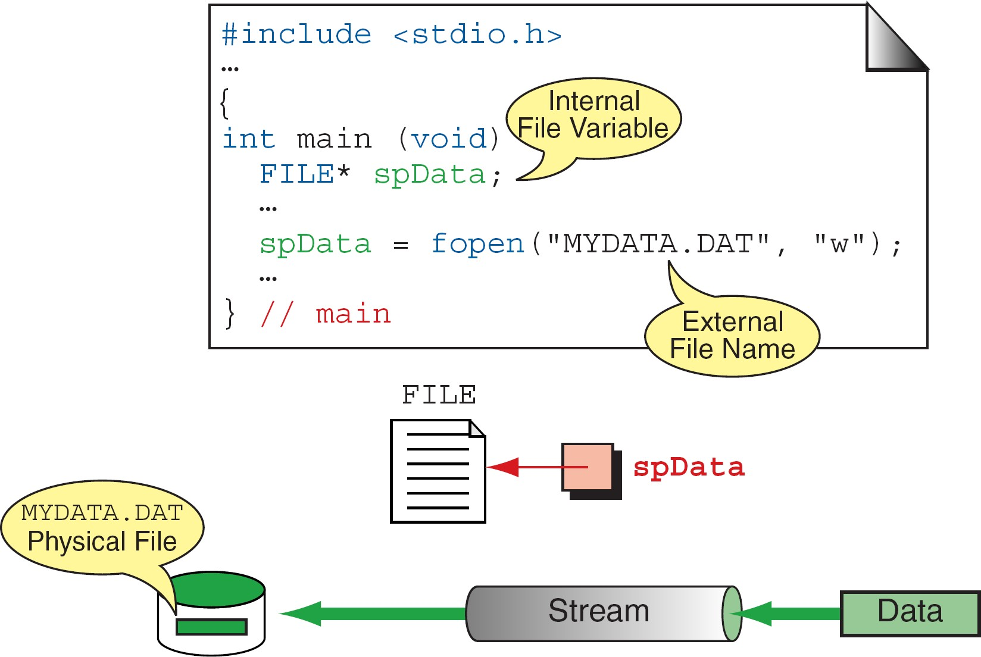
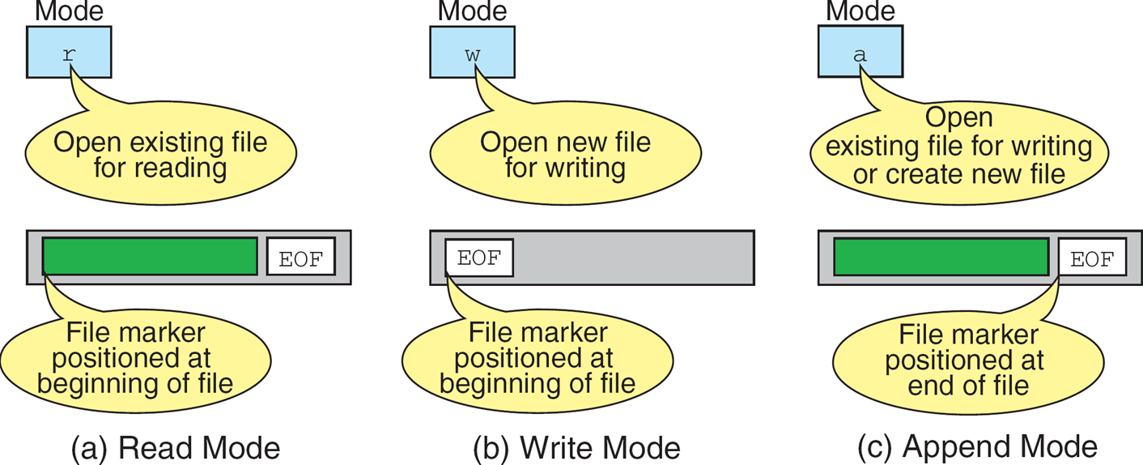
More On : fopen
[Reference from Figure (a) in Forouzan & Gilberg, p. 399]
[Reference from Figure (b) in Forouzan & Gilberg, p. 401]

Slide 10
End of File {eof}
There are several ways to test for the end-of-file feof condition.
The EOF is a constant, defined in the header file stdio.h.
One way is to use the value returned by the fscanf function.
FILE *fptr1; int istatus ; istatus = fscanf (fptr1, "%d", &var) ; if ( istatus == feof(fptr1) ) { printf ("End-of-file encountered.\n”) ; }

Slide 11
Closing a file
The fclose(filepointer) function returns zero on success, or EOF if there is an error in closing the file. This function actually flushes any data still pending in the buffer to the file, closes the file, and releases any memory used for the file.
Syntax: fclose(fp);
FILE *fptr;
char filename[]= "myfile.dat";
fptr = fopen (filename,"w");
if (fptr == NULL)
{
printf ("Cannot open file to write!\n"); exit(-1);
}
fprintf (fptr,"Hello World!\n"); fclose(fptr);

Slide 12
Basic File Operation
Function name | Operation
fopen() | Creates a new file for use Opens an existing file for use
fclose() | Closes a file which was opened for use
fputs() | Writes string to the file
fgets() | Reads string from the file
fgetc() | Reads a character from a file
fputc() | Writes a character to a file
fprintf() | Writes a set of data values to a file
fscanf() | Reads a set of data values from a file
fseek() | Sets the position to a desired point in the file
ftell() | Gives the current position in the file (in terms of bytes from the start)
rewind() | Sets the position to the beginning of the file

Slide 13
fprintf and fscanf
The fprintf() function is used to write set of characters into file. It sends formatted output to a stream.
Syntax:
int fprintf(FILE *stream, const char *format [, argument, ...])
#include <stdio.h>
main(){
FILE *fp;
fp = fopen("file.txt", "w");//opening file
fprintf(fp, "Hello file by fprintf...\n");//writing data into file
fclose(fp);//closing file
}
The fscanf() function is used to read set of characters from file. It reads a word from the file and returns EOF at the end of file.
Syntax:
int fscanf(FILE *stream, const char *format [, argument, ...])
#include <stdio.h>
main(){
FILE *fp;
char buff[255];//creating char array to store data of file
fp = fopen("file.txt", "r");
while(fscanf(fp, "%s", buff)!=EOF){
printf("%s ", buff );
}
fclose(fp);
}
In both functions’ syntax, input passes by two parameters. Those two parameters are as follows:
Stream: A stream is a pointer to the file that indicates the file object that recognizes the file stream.
Format: It is the parameter that tells about how to format the data according to the user's requirements.

Slide 14
Example: Storing employee information using fprintf and fscanf
#include <stdio.h>
void main()
{
FILE *fptr;
int id;
char name[30];
float salary;
fptr = fopen("emp.txt", "w+");/* open for writing */
if (fptr == NULL)
{
printf("File does not exists \n");
return;
}
printf("Enter the id\n");
scanf("%d", &id);
fprintf(fptr, "Id= %d\n", id);
printf("Enter the name \n");
scanf("%s", name);
fprintf(fptr, "Name= %s\n", name);
printf("Enter the salary\n");
scanf("%f", &salary);
fprintf(fptr, "Salary= %.2f\n", salary);
fclose(fptr);
}

Slide 15
fread ()
Declaration:
size_t fread(void *ptr, size_t size, size_t n, FILE *stream);
fread reads a specified number of equal-sized data items from an input stream into a block.
ptr = Points to a block into which data is read
size = Length of each item read, in bytes
n = Number of items read
stream = file pointer
Example:
#include<stdio.h>
int main()
{FILE *f;
char buffer[11];
if (f = fopen(“test.txt", “r”))
{ fread(buffer, 1, 10, f);
buffer[10] = 0; fclose(f);
printf("first 10 characters of the file:\n%s\n", buffer);
}return 0;}

Slide 16
fwrite()
Declaration:
size_t fwrite(const void *ptr, size_t size, size_t n, FILE*stream);
fwrite appends a specified number of equal-sized data items to an output file.
ptr = Pointer to any object; the data written begins at ptr size = Length of each data item in bytes
n = Number of data items to be appended stream = file pointer
Example:
#include <stdio.h> int main()
{char a[10]={'1','2','3','4','5','6','7','8','9','a'};
FILE *fs; fs=fopen("Project.txt","w"); fwrite(a,1,10,fs);
fclose(fs); return 0;}

Slide 17
Library Functions for Reading/Writing from/to a File
Once a file is opened, reading out from it or writing into it is accomplished using the standard I/O functions.
Writing to a File
fputc: It writes a character to the file, pointed to by file_pointer.
Syntax: fputc(char ch, File *fptr);
#include <stdio.h> int main() { int i; FILE * fptr; char str[] = "abc\n"; fptr = fopen("test.txt", "w"); for (i = 0; str[i] != '\n'; i++) { fputc(str[i], fptr); } fclose(fptr); }

Slide 18
2. fputs: It writes a string to the file pointed to by file_pointer.
Syntax: fputs(char *str, file *fp);
Example:
#include <stdio.h> void main() { FILE * fp; fp = fopen("test.txt", "w"); fputs("This is test for fputs( ),", fp); fclose(fp); }

Slide 19
Reading data from a File
There are two different functions dedicated to reading data from a file
fgetc: It returns the character from the file pointed by the file pointer.
Syntax: fgetc(file *fp);
#include <stdio.h> void main() { FILE * fp; char c; printf("Data that is read from the file is:\n"); fp = fopen("test.txt", "r"); while ((c = fgetc(fp)) != EOF) { printf("%c", c); } fclose(fp); }

Slide 20
2.fgets: It reads n-1 characters from the file and stores the string in a buffer in which the NULL character '\0' is appended as the last character.
Syntax: fgets(char *str, int n, file *fptr);
#include <stdio.h>
void main()
{
FILE *fptr;
char line [100];
fptr=fopen("test.txt","r");
while (fgets(line,100,fptr) != NULL)
{
printf ("Content retrieved and is being displayed: %s\n", line);
}
fclose(fptr);
}

Slide 21
Copying the contents of a file into another file:
#include<stdio.h>
void main()
{
FILE *fp1,*fp2;
char ch;
fp1=fopen("test1.txt","r");
fp2=fopen("test2.txt","w");
if(!fp1)
perror("Error");
while((ch=fgetc(fp1))!=EOF)
{
printf("%c",ch);
fputc(ch,fp2);
}
fclose(fp1);
fclose(fp2);
}

Slide 22
Renaming existing file:
#include<stdio.h>
#include<conio.h>
void main()
{
FILE *fp;
char oldname[20],newname[20];
clrscr();
printf("Mention the old file name");
gets(oldname);
printf("Mention the new name");
gets(newname);
if(rename(oldname, newname) ==0)
puts("File renamed");
else
puts("File not renamed");
fclose(fp);
getch();
}
Syntax:
rename(oldname, newname)
if(rename("test1.txt", "test2.txt")==0){
puts("file renamed").
}

Slide 23
Files: Concept of Binary Files,
Accessing a file randomly using ftell & fseek.

Slide 24
Text & Binary Files
A text file, also known as a flat file or an ASCII file, is structured as a sequence of lines of alphabet, numerals, special characters, etc.
However, the data in a text file, whether numeric or non-numeric, is stored using its corresponding ASCII code.
The end of a text file is often denoted by placing a special character, called an end-of-file marker, after the last line in the text file.
A binary file contains any type of data encoded in binary form for computer storage and processing purposes.
A binary file can contain text that is not broken up into lines.
A binary file stores data in a format that is similar to the format in which the data is stored in the main memory.

Slide 25
Binary Files
Therefore, a binary file is not readable by humans and it is up to the program reading the file to make sense of the data that is stored in the binary file and convert it into something meaningful.
Binary files contain formatting information that only certain applications or processors can understand.
binary files must be run on an appropriate software or processor so that the software or processor can transform the data in order to make it readable.
For ex: only Microsoft Word can interpret the formatting information in a Word document.

Slide 26
Writing into a binary file
#include<stdio.h> void main() { char status='Y'; FILE *fp; struct student { char name[10]; int reg_no; float marks; }s;
fp=fopen("stud.dat","wb"); if (!fp) perror(“Error "); while(status=='Y') { puts("Enter details"); printf("Enter name, reg no, marks\n"); scanf("%s%d%f",s.name,&s.reg_no,&s.marks); fwrite(&s,sizeof(s),1,fp); status=getche(); } fclose(fp); }
The perror() function in C is used to print an error message to standard error (stderr). It takes one argument, which is a pointer to a string. The string is printed to stderr, followed by a colon, a space, and the error message corresponding to the value of the global variable errno.
perror("fopen");
Will show following error message:
fopen: No such file or directory

Slide 27
Reading from a binary file
#include<stdio.h> void main() { FILE *fp; struct student { char name[10]; int reg_no; float marks; }s; fp=fopen("stud.dat","rb"); if (!fp) perror("Error"); puts("Reading"); while(!feof(fp)) fread(&s,sizeof(s),1,fp); printf("%s\n%d\n%f", s.name, s.reg_no,s.marks); fclose(fp); }

Slide 28
Appending from a binary file
#include<stdio.h> void main() { char status='Y'; FILE *fp; struct student { char name[10]; int reg_no; float marks; }s;
fp=fopen("stud.dat","ab"); if (!fp) perror(" Appending error "); //Appending while(status=='Y') { puts("Enter details"); printf("Enter name, reg no, marks\n"); scanf("%s%d%f",s.name,&s.reg_no,&s.marks); fwrite(&s,sizeof(s),1,fp); status=getche(); } fclose(fp); }

Slide 29
Sequential vs Random file Organization
Sequential file organization is the most basic way to organize a large collection of records in a file.
A sequentially organized file stores the records in the order in which they were entered.
Every open file has an associated file position indicator, which describes where read and write operations take place in a file.
The position is always specified in bytes from the beginning of the file.
When a new file is opened, the position indicator is always at the beginning of the file.
When an existing file is opened, the position indicator is at the end of file. (Depends on Mode)

Slide 30
Use of file pointer for random access…
While opening a file in write mode, the file pointer is at the beginning of the file, and while writing into a file, the file pointer moves to the end of the data, so that writing can continue from that point.
While opening a file in read mode, the file pointer is at the beginning of the file, and while reading from a file, the file pointer moves to the beginning of the next data item so that reading can continue from that point.
While opening a file in append mode, the file pointer is at the end of the existing file, so that new data can be written from there onwards.
Moving file pointer according as user needs, so that data can be read from a file or written onto a file randomly…………Random Access

Slide 31
Sequential vs Random file Organization
If one wishes to read all the data in a file sequentially or write data to a file sequentially, it is not necessary to be concerned about the position indicator because the stream I/O functions take care of it automatically.
When more control is required, Fseek, Ftell and rewind library functions determine and change the value of the file position indicator. By controlling the position indicator, random access of a file can be made possible.
Random access means you can read from or write to any position in a file without reading or writing the proceeding data.

Slide 32
Functions used in random access
1. ftell():
This function takes a file pointer as an argument and returns a number of type long, that indicate the current position of the file pointer within the file.
This function is useful in saving the current position of a file, which can be used later in the program.
Syntax : n = ftell(fp);
Note: n would give the relative offset (in bytes) of the current position.
It means that n bytes have already been read (or written).

Slide 33
Functions used in random access
2. rewind():This function takes a file pointer as argument and resets the current position of the file pointer to the start of the file.
Syntax: rewind(fp);
rewind(fp);
n=ftell(fp); // it will return 0
Note: n would be assigned 0 because the file position has been set to the start of the file by rewind().
The first byte in the file is numbered as 0, the second as 1, and so on.

Slide 34
Functions used in random access…
3. fseek(): This function is used to move the file pointer to a desired position within a file.
Syntax : fseek(fp, offset, origin);
fp is a file pointer,
offset is a number that indicates the number of bytes, the position indicator is about to move,
origin specifies the relative starting point from where it is to be modified. The Origin can have one of the following 3 values:
Value | Meaning
SEEK_SET (or 0) | Beginning of file
SEEK_CUR (or 1) | Current position
SEEK_END (or 2) | End of file
When the operation is successful, fseek() returns a 0 (zero).
We can also use integer values 0, 1, and 2 for the origin

Slide 35
fseek()
0 | 1 | 2 | 3 | 4 | 5 | 6 | 7
A | B | C |  | P | Q | R | S
// C Program to demonstrate the use of fseek()
#include <stdio.h>
int main()
{
FILE* fp;
fp = fopen("test.txt", "r");
// Moving pointer to end
fseek(fp, 5, SEEK_SET); // move the cursor forward
// Printing position of pointer
printf("%ld", ftell(fp));
fseek(fp, -3, SEEK_CUR); // move the cursor backward
printf("%ld", ftell(fp));
return 0;
}
First fseek will set the cursor at (0+5)th position. i.e. at q
Second fseek will set the cursor at (5-3) position. i.e. at c

